Slide 1
Diode Resistance With Static And Dynamic Resistance
A.NIKITHA
CSM-C
22H51A66D1
SlideMake.com

Slide 2
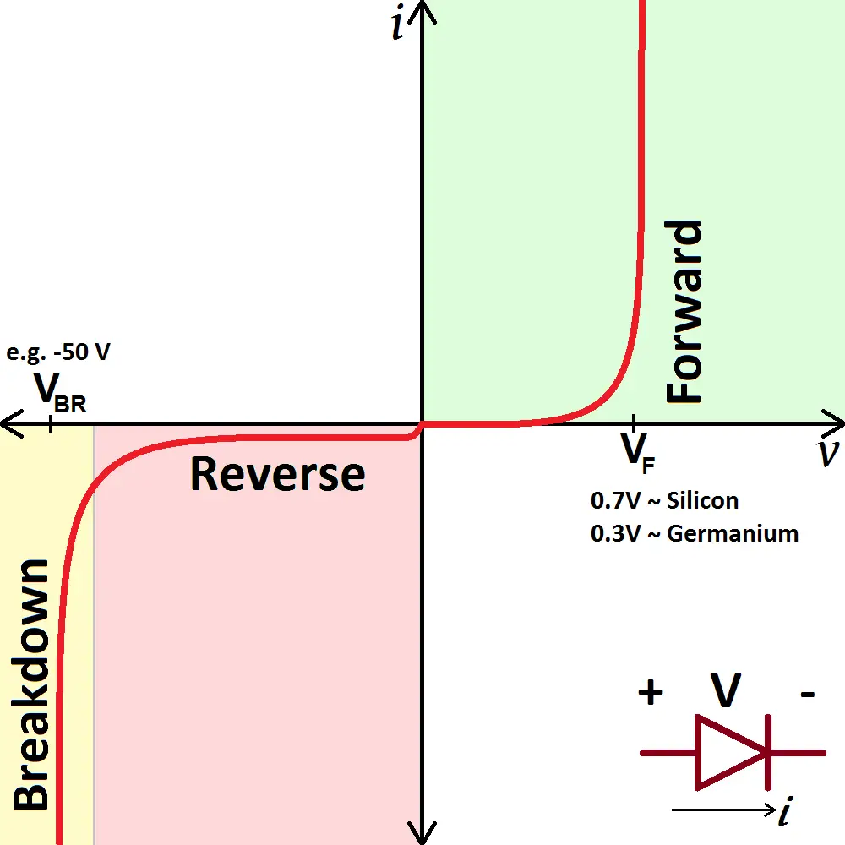
Introduction
Diode resistance is an important characteristic that affects the performance of diodes.
Diodes exhibit both static and dynamic resistance.
Understanding diode resistance is crucial for designing and analyzing electronic circuits.
1
Notes:
Image source: http://electricalacademia.com/electronics/diode-characteristic-curve-explanation/

Slide 3
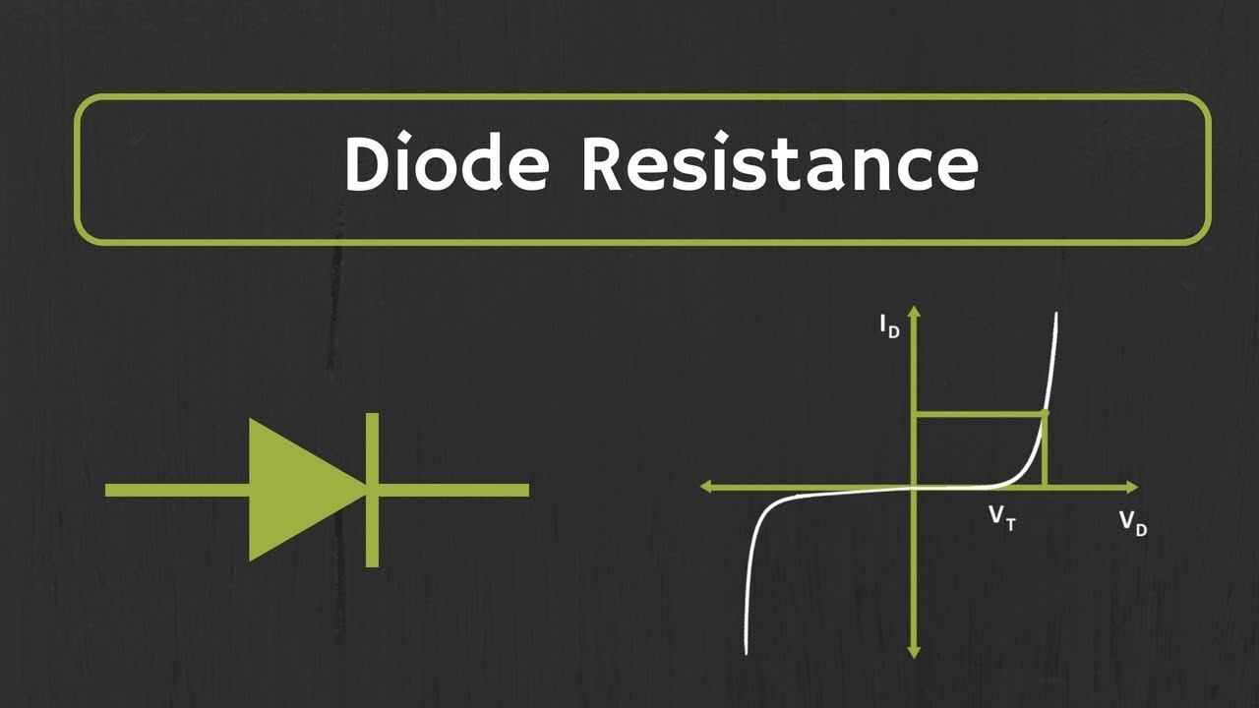
Static Resistance
Static resistance, also known as DC resistance, refers to the diode's resistance when it is biased with a constant voltage or current.
It is a measure of how much the voltage across the diode changes with respect to the current flowing through it.
Static resistance is typically specified as the ratio of the voltage change to the current change (ΔV/ΔI).
2
Notes:
Image source: https://eruhul.wordpress.com/2019/01/24/static-and-dynamic-resistance-of-a-diode/

Slide 4
Factors Affecting Static Resistance
The material used in the diode construction determines the static resistance.
Silicon diodes have a lower static resistance compared to germanium diodes.
The doping level and temperature also influence the static resistance of a diode.
3
Notes:
Image source: https://www.tes.com/teaching-resource/investigating-factors-affecting-resistance-rp15-gcse-physics-12742665

Slide 5
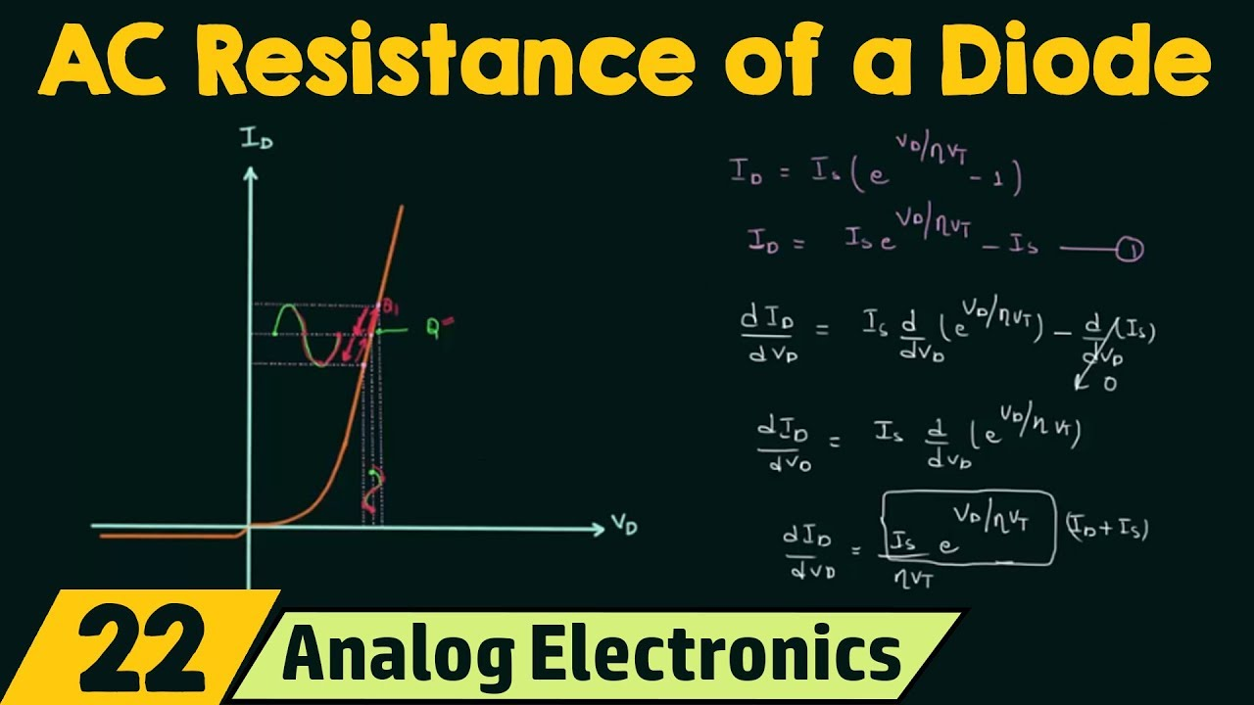
Dynamic Resistance
Dynamic resistance, also known as AC resistance or incremental resistance, refers to the resistance of a diode when it is subjected to small signal variations around a bias point.
It is a measure of how the voltage across the diode changes when the current through it varies slightly.
Dynamic resistance is typically calculated as the ratio of the small change in voltage to the small change in current (ΔV/ΔI).
4
Notes:
Image source: http://www.youtube.com/watch?v=6QlFxif-JfQ

Slide 6
Factors Affecting Dynamic Resistance
Dynamic resistance is influenced by the diode's operating point and the signal frequency.
As the current through the diode increases, the dynamic resistance decreases.
Higher signal frequencies tend to increase the dynamic resistance due to the internal capacitance of the diode.
5
Notes:
Image source: http://www.youtube.com/watch?v=6QlFxif-JfQ

Slide 7

Relationship between Static and Dynamic Resistance
Static resistance and dynamic resistance are related but have different characteristics.
Static resistance is a constant value, while dynamic resistance varies with the operating conditions.
Dynamic resistance can be considered as the slope of the voltage-current characteristic curve of the diode.
6
Notes:
Image source: http://www.differencebetween.net/technology/difference-between-dynamic-and-static-hashing/

Slide 8
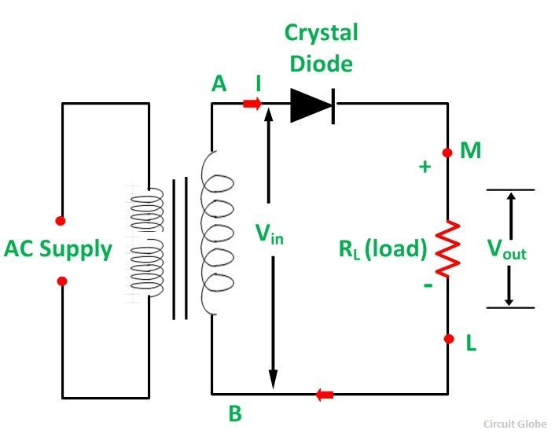
Applications of Diode Resistance
The knowledge of diode resistance is essential in rectifier circuits to determine the power dissipation and voltage drop across the diode.
In amplifier circuits, the dynamic resistance plays a crucial role in determining the gain and stability.
Diode resistance is also important in signal processing applications, such as in frequency modulation and demodulation circuits.
7
Notes:
Image source: https://mydiagram.online/led-diode-diagram/

Slide 9
Conclusion
Diode resistance, comprising of static and dynamic resistance, is a critical factor in diode performance and circuit design.
Static resistance determines the voltage-current relationship of the diode under constant bias conditions.
Dynamic resistance affects the diode's behavior under small signal variations and at different operating points. Understanding and considering both types of resistance is essential for successful application of diodes in electronic circuits.
10
Notes:
Image source: https://eruhul.wordpress.com/2019/01/24/static-and-dynamic-resistance-of-a-diode/

Slide 10
Thank You

